Slide 1
Renton Nip
Program Manager, Hokukahu LLC
DRAFT | PRE-DECISIONAL
VA VistA Metadata
Kickoff Brief
January 7, 2016
“Medically Ready Force…Ready Medical Force”

Slide 2
Agenda
Introductions
  The Team
  Project Overview
    Project Description
    Project Financials
    Staffing
  Project Technical Objectives
    Deliverable Overview & Schedule
    Technical Approach, & Summary
  Project Threats, Risks & Mitigations
  Project Assumptions
  Decisions
  Action Items
Q&A
Wrap Up
“Medically Ready Force…Ready Medical Force”

Slide 3
The Team
Hokukahu, LLC
  Hokukahu, LLC (Hokukahu) will serve as the prime contractor for the VISTA Metadata project. Headquartered in Honolulu, Hawaii, Hokukahu is a Native Hawaiian Organization-Owned Concern in the Small Business Administration’s 8(a) Business Development Program.
  Hokukahu employees who worked on the TAPS project who will continue in the VISTA Metadata project include: Brad Goo (Systems and Integration SME), David Booth (RDF and HL7 SME), and Renton Nip (Program/Contract Manager).
Caregraf, Inc.
  Caregraf, Inc. (Caregraf) specializes in standards-based software solutions that developed the open source FileMan Query Language (FMQL). FMQL was used in TAPS to extract all data and meta-data from CHCS’s NoSQL data store called FileMan.
  Conor Dowling, President of Caregraf, worked on the TAPS project and will continue in the VISTA Metadata project serving as Project Architect.
J2 Interactive, LLC
  Ed de Moel, VISTA System and MUMPS SME
HRG Technologies LLC
  Steve Bruno, Senior Software Developer
  Sonny Kim, Senior Software Developer
“Medically Ready Force…Ready Medical Force”

Slide 4
Project Overview: Project Description
Project Description
The Project will provide a single comprehensive security enabled read/write data model for all VA VISTA data across all VA VISTA operational systems, establishing a common technical foundation for master data management and computable data representation and exchanging between VA and DoD clinical information systems.
All artifacts and deliverables shall be developed, version-controlled, stored, and delivered on an industry-standard public Github repository
Functional Benefits
Permits analysis and enhancement of the true operational VISTA data models and provide a data- and metadata-centric roadmap for auditing VISTA data. This automation creates a sustainable, continuously repeatable process across all systems going forward rather than a single snapshot in time.
Provides the foundation for enterprise-centric Master Data Management for VISTA. This is the foundation for code reduction and elimination of multiple overlapping extraction methods.
Enables highly contextualized and personalized patient data enrichment and patient-centric security.
Key Capabilities
Provide comprehensive always-up-to-date, machine-processable exposure and definition of complete operational VISTA data model (VDM), based on all data dictionaries from all active VISTA instances in standard machine-processable, exchangeable form, supported by off-the-shelf tools.
Create a fully audited and normalized VISTA data model (VDMN) with no redundancy.
Modify FileMan data to allow management (query, security, read/write) of Patient, Institutional, Knowledge, and Systems data as distinct entities and to enable patient-centric security.
Stakeholders
PMO Lead: CAPT Paul Miller
Program Manager: Renton Nip, Hokukahu
Functional Sponsor: Mark Goodge
Functional Proponents (VA): Rafael Richards, MD, Reese Omizo, MD
“Medically Ready Force…Ready Medical Force”

Slide 5
Project Overview: Project Financials
12/31/2015 - 12/30/2016
Direct Labor
ODCs
TOTAL
Redacted to make sharable
“Medically Ready Force…Ready Medical Force”

Slide 6
Project Overview: Staffing
Labor Category | FTE over PoP | Function
Program/Contract Manager | .5 | Organizes, directs, and manages contract operation and personnel
Subject Matter Expert (Master) | 3 | Serves as SME, possessing in-depth knowledge of highly specialized applications/systems.
Applications Developer (Master) | 4 | Designs, develops, enhances, debugs, and implements software or major enhancements to existing software.
Applications Developer (Senior) | 3 | Designs, develops, enhances, debugs, and implements software or major enhancements to existing software.
Test Engineer (Senior) | .5 | Evaluates and implements test tools and strategies. Designs and conducts test and evaluation procedures.
Technical Writer (Senior) | 1 | Produces and reviews content of technical documentation as appropriate to the requirements.
Project Manager | 1 | Provides Project management and scrum master roles.
“Medically Ready Force…Ready Medical Force”

Slide 7
Project Technical Objectives:
Deliverable Overview & Schedule
Deliverable | Frequency
Project Repository (Deliverable #1AA) | Prior to Work Performance
Non-Disclosure/Non-Use Agreement Deliverable #1A) | Prior to Work Performance
Quality Control Plan (Deliverable #1B) | 30 days after contract award
Phase-Out Migration Plan (Deliverable #1C) | 30 days prior to end of contract
Program Management Plan (Deliverable #2) | At contract award; and updated within 30 days after contract award
“Medically Ready Force…Ready Medical Force”

Slide 8
Project Technical Objectives:
Deliverable Overview & Schedule (cont.)
Deliverable | Frequency
Program Schedule and Monthly Updates (Deliverable #3) | Monthly, the 30th day of the following month
Monthly Progress Report (Deliverable #4) | Monthly, the 30th day of the following month
Quarterly Strategic Communications Message (Deliverable #5) | Quarterly, 5th day following end of each quarter
Date-stamped FileMan Data Model Definitions (Deliverable #8) | Per approved project schedule; with continuous, real-time access on the Github as developed
Approach to “Live VDM” Maintenance of Current State (Deliverable #9) | Per approved project schedule; with continuous, real-time access on the Github as developed
Normalized VISTA Data Model (VDMN) (Deliverable #10) | Per approved project schedule; with continuous, real-time access on the Github as developed
Heuristic Code (Deliverable #11) | Per approved project schedule; with continuous, real-time access on the Github as developed
“Medically Ready Force…Ready Medical Force”

Slide 9
Project Technical Objectives:
Deliverable Overview & Schedule (cont.)
Deliverable | Frequency
Normalization Reports (Deliverable #12) | Per approved project schedule; with continuous, real-time access on the Github as developed
Website that graphically depicts VDM, VDMN, and other metadata (Deliverable #13) | Per approved project schedule; with continuous, real-time access on the Github as developed
Report on Exposure of Older Models (Deliverable #14) | Per approved project schedule; with continuous, real-time access on the Github as developed
Date-stamped Metadata for lab, surgery, TIU notes and other applications in a VDMN compatible format (Deliverable #15) | Per approved project schedule; with continuous, real-time access on the Github as developed
Machine-processable Annotations (Deliverable #18) | Per approved project schedule; with continuous, real-time access on the Github as developed
Software code (Deliverable #19) | Per approved project schedule; with continuous, real-time access on the Github as developed
Prototype query access to VISTA Data Against VDM (Deliverable #25) | Per approved project schedule; with continuous, real-time access on the Github as developed
“Medically Ready Force…Ready Medical Force”

Slide 10
Project Technical Objectives:
Deliverable Overview & Schedule (cont.)
Deliverable | Frequency
Prototype Patient-centric Data Security (Deliverable #28) | Per approved project schedule; with continuous, real-time access on the Github as developed
Prototype Web-Based Rules Hub (Deliverable #32) | Per approved project schedule; with continuous, real-time access on the Github as developed
Prototype Web-Based Query Interface to FileMan Data (Deliverable #33) | Per approved project schedule; with continuous, real-time access on the Github as developed
VISTA Application model(s)/Prototype(s) (Deliverable #35) | Per approved project schedule; with continuous, real-time access on the Github as developed
Meta-model(s)/Prototype(s) (Deliverable #36) | Per approved project schedule; with continuous, real-time access on the Github as developed
Reference model(s)/Prototype(s) (Deliverable #39) | Per approved project schedule; with continuous, real-time access on the Github as developed
Document VISTA-ese vs. FHIR (Deliverable #40) | Per approved project schedule; with continuous, real-time access on the Github as developed
“Medically Ready Force…Ready Medical Force”

Slide 11
Project Technical Objectives:
Deliverable Overview & Schedule (cont.)
First Deliverables:
  Deliverable 1AA: Project Repository
    Friday, January 8
    Will email URL to the COR
  Deliverable 2: Program Management Plan
    Friday, January 8
    To be posted on Project Repository
  Deliverable 13: Initial Website
    Friday, January 15
“Medically Ready Force…Ready Medical Force”

Slide 12
Project Technical Objectives:
Technical Approach
The technical approach that Team Hokukahu will be adopting for the VISTA Metadata Project is largely the same that the Team used in the TAPS Project and more recently, in the LPI Project.
The specific technical approach to each deliverable is set forth in the Technical Proposal and will be further detailed in the Program Management Plan (PMP).
The Project Architecture is depicted on the following slide.
“Medically Ready Force…Ready Medical Force”

Slide 13
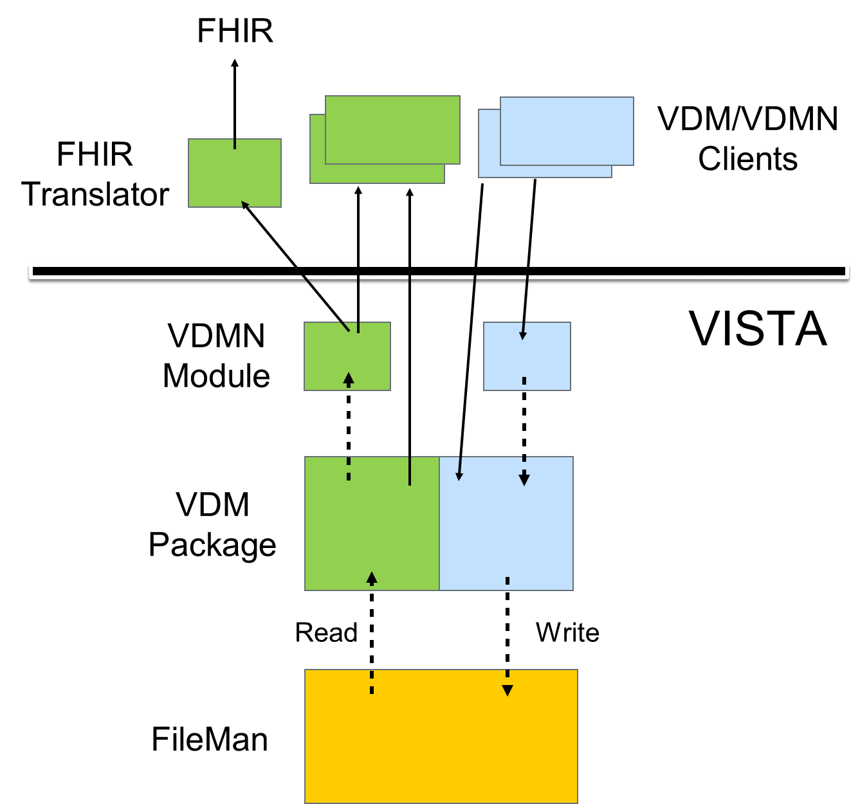
Project Technical Objectives: Technical Approach – Project Architecture
“Medically Ready Force…Ready Medical Force”

Slide 14
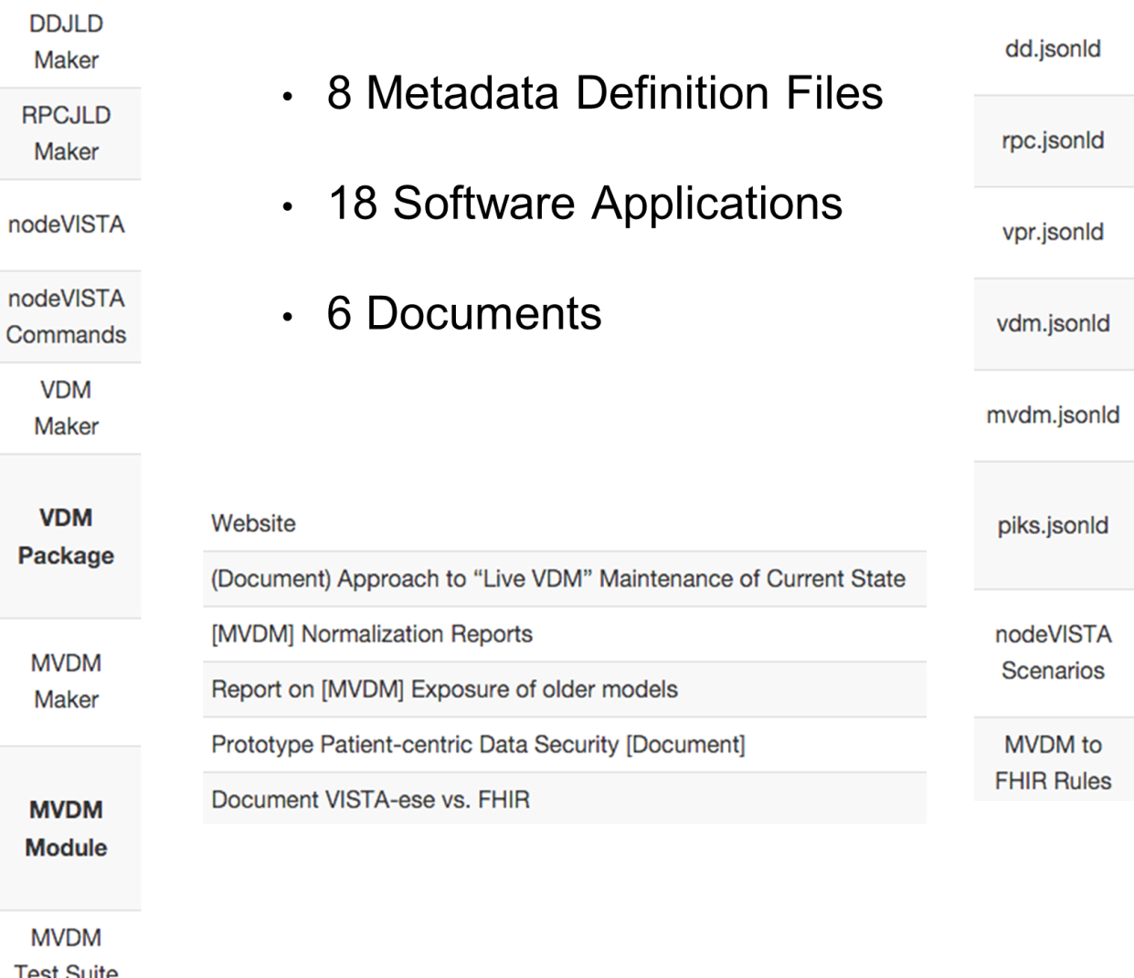
Project Technical Objectives: Technical Approach – Project Artifacts
“Medically Ready Force…Ready Medical Force”

Slide 15
Project Threats Risks and Mitigations
Request for GFE & Information
The PWS requires that within 30 DACA the Government provide the following GFE/GFI:
  Data Dictionary (DD) extracts from at least five current operational VISTA systems.
  Current authoritative Master version of VISTA as maintained internally by the VA. Metadata from this must be complete and without any alterations or redactions.
  Copy of a VISTA with test patients used by VA for internal projects.
  Copy of at least one real operational VISTA to be kept within the NIPR network, as it will have non de-identified patient data.
  A VISTA with real but de-identified patient data.
Potential mitigation and impact:
  Mitigation: Use open source OSEHRA VISTA images and resources.
  Impact: Image is neither a current nor a true VA VISTA image.
“Medically Ready Force…Ready Medical Force”

Slide 16
Project Threats, Risks & Mitigations
Additional GFE & GFI Requests
In its Technical Response, the Team requested that additional GFE and GFI be provided within 30 days of contract award to successfully execute the Project.
In the contracting process, the Contract Specialist (CS) intended to satisfy such request by incorporating the Technical Proposal into the contract. Legal demurred, due to recent FOIA requests for technical proposals. The CS suggested resolution at the post-award conference. The additional GFE/GFI for project success are:
A copy of the latest version of the VPR RPC software and documentation;
The latest copy of the FileMan namespace spreadsheet;
A FileMan namespace exclusively for the Team to allow for the creation of Project files and fields in FileMan;
Access to the most up-to-date VISTA Integrations Agreements;
Sufficient InterSystems Cache licenses to host FileMan Test VISTA systems; and
VA VISTA Sandbox Account with full Linux VM.
“Medically Ready Force…Ready Medical Force”

Slide 17
Project Assumptions
The required GFE/GFI will be provided to the Team on a timely basis.
The required access to the ITEC will be provided to the Team on a timely basis.
“Medically Ready Force…Ready Medical Force”

Slide 18
Mahalo!
“Medically Ready Force…Ready Medical Force”

